Slide 1
Web程式設計
JavaScript
授課教師:陳錫民
Email: hsiminc@fcu.edu.tw

Slide 2
JavaScript
Scripting language which is used to enhance the functionality and appearance of web pages.
Before you can run code examples with JavaScript on your computer, you may need to change your browser’s security settings.
IE9 prevents scripts on the local computer from running by default
Firefox, Chrome, Opera, Safari (including on the iPhone) and the Android browser have JavaScript enabled by default.

Slide 3
Your First Script: Displaying a Line of Text with JavaScript in a Web Page
We begin with a simple script that displays the text "Welcome to JavaScript Programming!" in the HTML5 document.
All major web browsers contain JavaScript interpreters, which process the commands written in JavaScript.

Slide 4
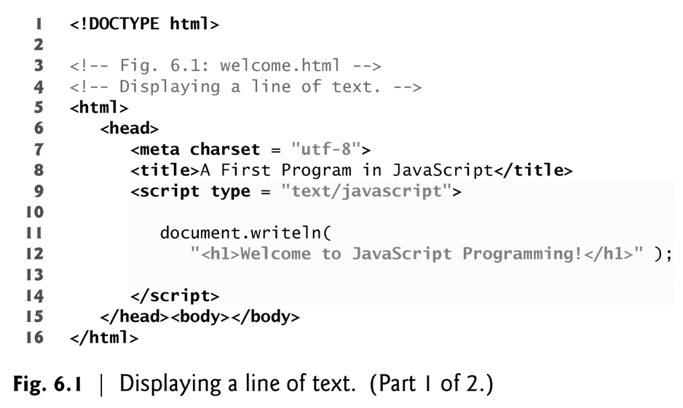
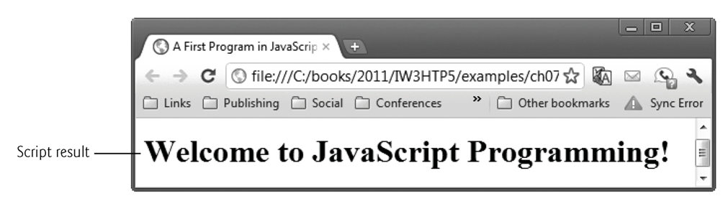

Slide 5
Your First Script: Displaying a Line of Text with JavaScript in a Web Page
Often, JavaScripts appear in the <head> section of the HTML5 document
The browser interprets the contents of the <head> section first
The <script> tag indicates to the browser that the text that follows is part of a script. Attribute type specifies the scripting language used in the script—such as text/javascript

Slide 6
The script Element and Commenting Your Scripts
The <script> tag indicates to the browser that the text which follows is part of a script.
The type attribute specifies the MIME type of the script as well as the scripting language used in the script—in this case, a text file written in javascript.
In HTML5, the default MIME type for a <script> is "text/javascript", so you can omit the type attribute from your <script> tags.
You’ll see it in legacy HTML documents with embedded JavaScripts.

Slide 7
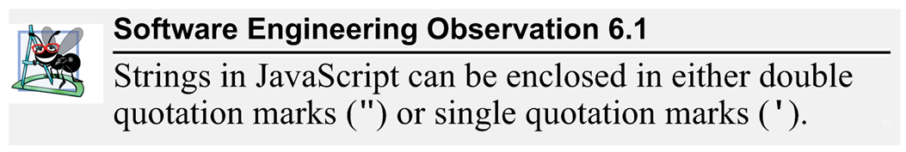
The script Element and Commenting Your Scripts
A string of characters can be contained between double quotation (") marks (also called a string literal)

Slide 8
The script Element and Commenting Your Scripts
Browser’s document object represents the HTML5 document currently being displayed in the browser
Allows you to specify HTML5 text to be displayed in the HTML5 document
Browser contains a complete set of objects that allow script programmers to access and manipulate every element of an HTML5 document
Object
Resides in the computer’s memory and contains information used by the script
The term object normally implies that attributes (data) and behaviors (methods) are associated with the object
An object’s methods use the attributes’ data to perform useful actions for the client of the object—the script that calls the methods

Slide 9
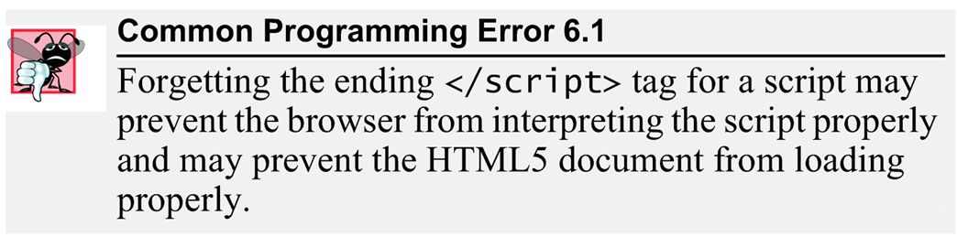
The script Element and Commenting Your Scripts
Every statement should end with a semicolon (also known as the statement terminator), although none is required by JavaScript
JavaScript is case sensitive
Not using the proper uppercase and lowercase letters is a syntax error

Slide 10
The script Element and Commenting Your Scripts
The document object’s writeln method
Writes a line of HTML5 text in the HTML5 document
Does not guarantee that a corresponding line of text will appear in the HTML5 document.
Text displayed is dependent on the contents of the string written, which is subsequently rendered by the browser.
Browser will interpret the HTML5 elements as it normally does to render the final text in the document

Slide 11
A Note About Embedding JavaScript Code into HTML5 Documents
JavaScript code is typically placed in a separate file, then included in the HTML5 document that uses the script.
This makes the code more reusable, because it can be included into any HTML5 document—as is the case with the many JavaScript libraries used in professional web development today.

Slide 12
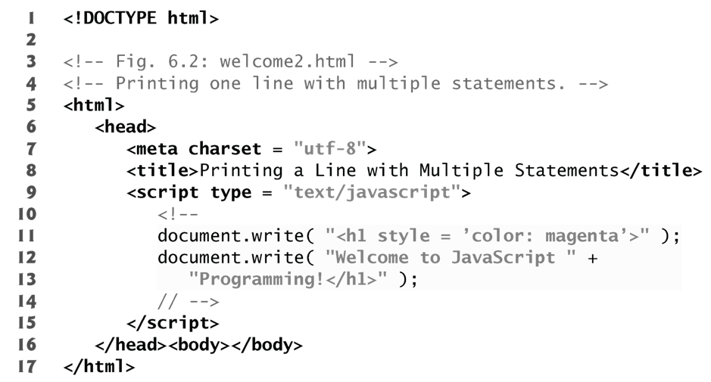
Modifying Your First Script
A script can display Welcome to JavaScript Programming! in many ways.
using the CSS color property.
Method write displays a string like writeln, but does NOT position the output cursor in the HTML5 document at the beginning of the next line after writing its argument

Slide 13
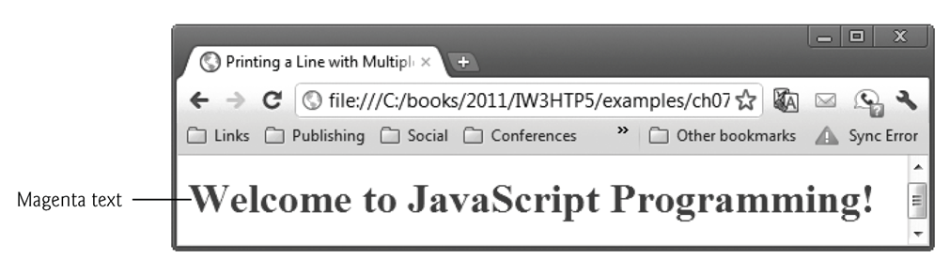
The + operator (called the “concatenation operator” when used in this manner) joins two strings together

Slide 14
Displaying Text in an Alert Dialog
Dialogs
Useful to display information in windows that “pop up” on the screen to grab the user’s attention
Typically used to display important messages to the user browsing the web page
Browser’s window object uses method alert to display an alert dialog
Method alert requires as its argument the string to be displayed

Slide 15
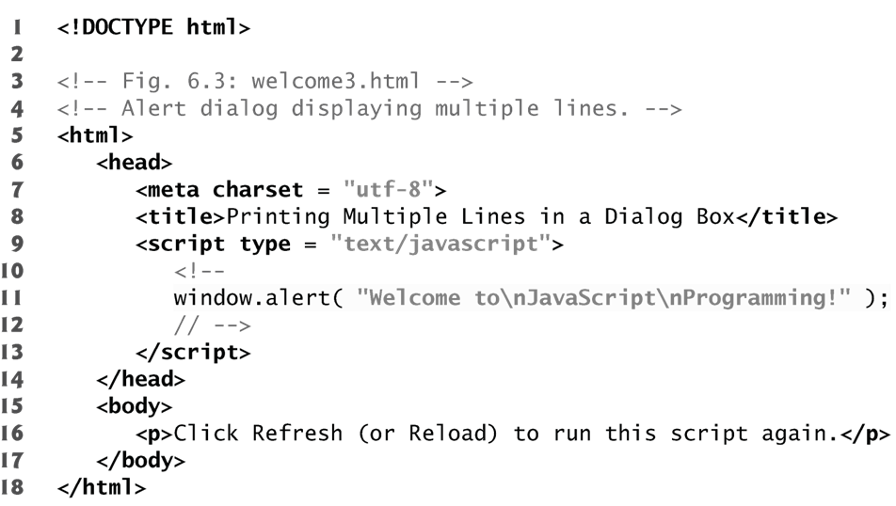
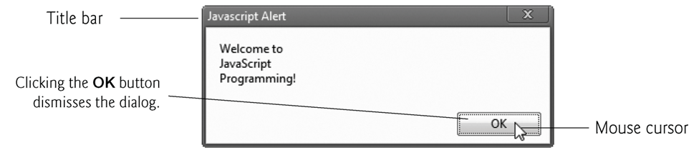

Slide 16
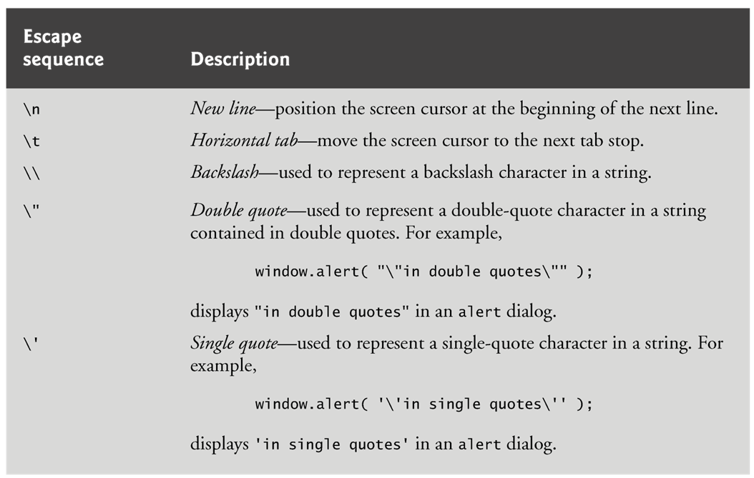
Escape Sequences
When a backslash is encountered in a string of characters, the next character is combined with the backslash to form an escape sequence. The escape sequence \n is the newline character. It causes the cursor in the HTML5 document to move to the beginning of the next line.

Slide 17
Obtaining User Input with prompt Dialogs
Gives you the ability to generate part or all of a web page’s content at the time it is shown to the user
Such web pages are said to be dynamic, as opposed to static, since their content has the ability to change

Slide 18
Dynamic Welcome Page
The next script creates a dynamic welcome page that obtains the user’s name, then displays it on the page.
The script uses another predefined dialog box from the window object—a prompt dialog—which allows the user to enter a value that the script can use.

Slide 19
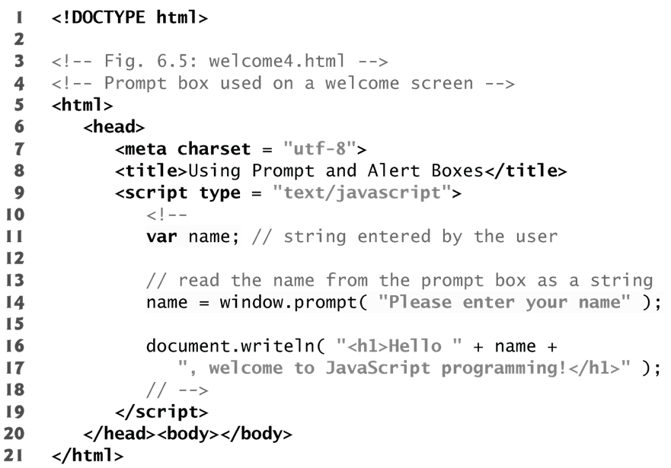
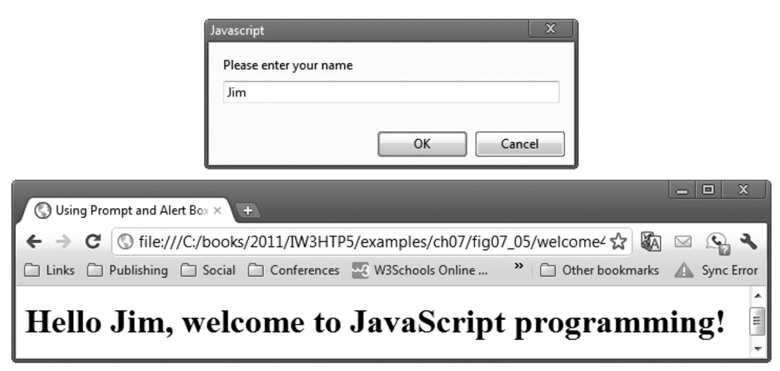

Slide 20
Dynamic Welcome Page
Keywords are words with special meaning in JavaScript
Keyword var
Used to declare the names of variables
A variable is a location in the computer’s memory where a value can be stored for use by a script
All variables have a name, type and value, and should be declared with a var statement before they are used in a script
A variable name can be any valid identifier consisting of letters, digits, underscores ( _ ) and dollar signs ($) that does NOT begin with a digit and is not a reserved JavaScript keyword.

Slide 21
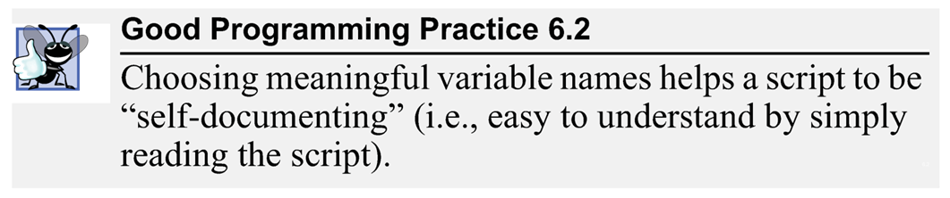
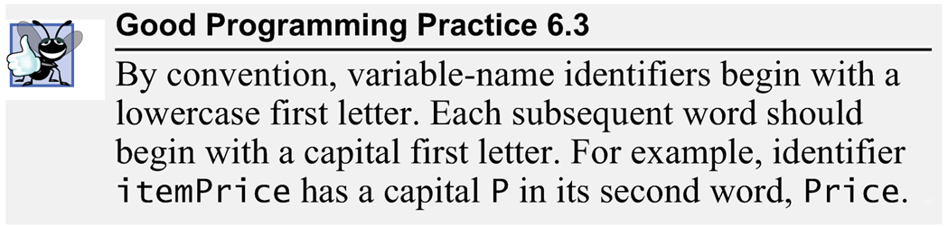
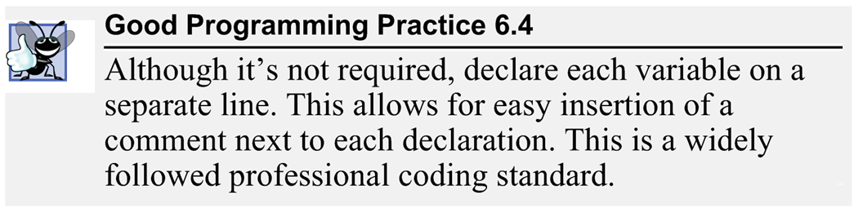
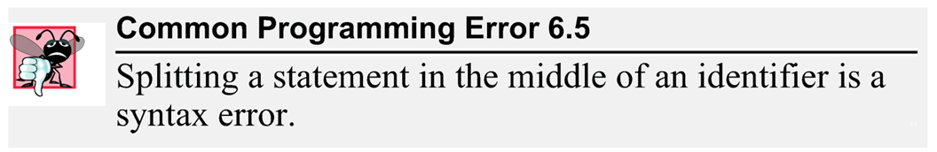

Slide 22
Dynamic Welcome Page
Comments
A single-line comment begins with the characters // and terminates at the end of the line
Comments do not cause the browser to perform any action when the script is interpreted; rather, comments are ignored by the JavaScript interpreter
Multiline comments begin with delimiter /* and end with delimiter */
All text between the delimiters of the comment is ignored by the interpreter.

Slide 23
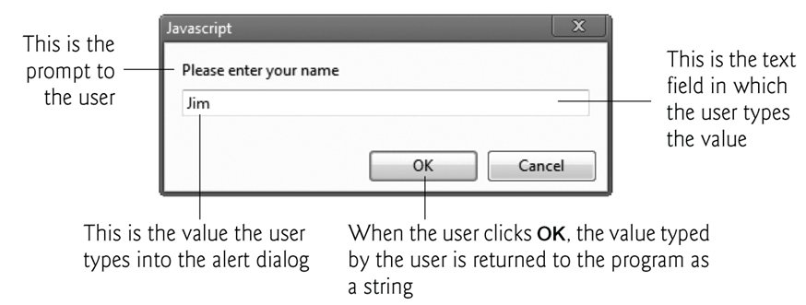
Dynamic Welcome Page
The window object’s prompt method displays a dialog into which the user can type a value.
The first argument is a message (called a prompt) that directs the user to take a specific action.
The optional second argument is the default string to display in the text field.
Script can then use the value that the user inputs.

Slide 24
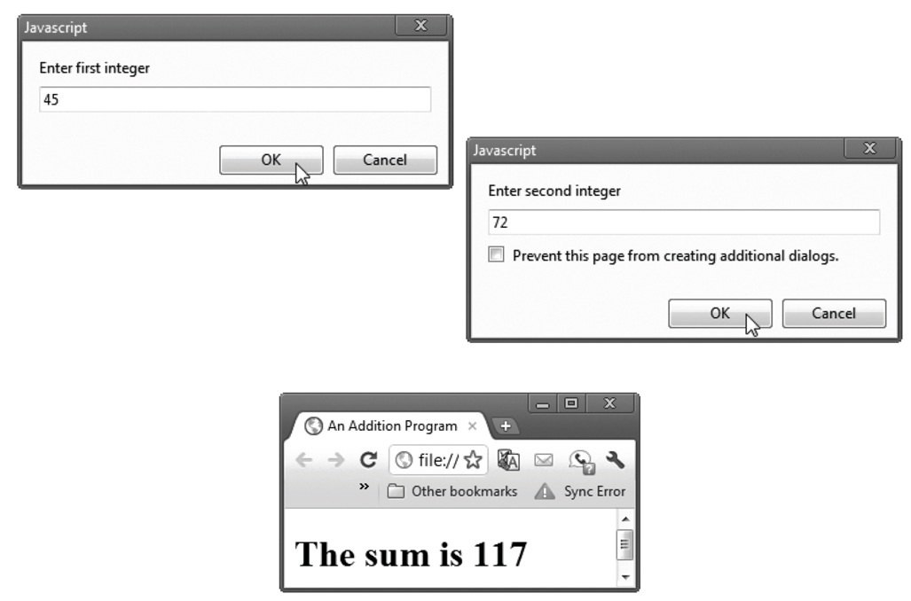
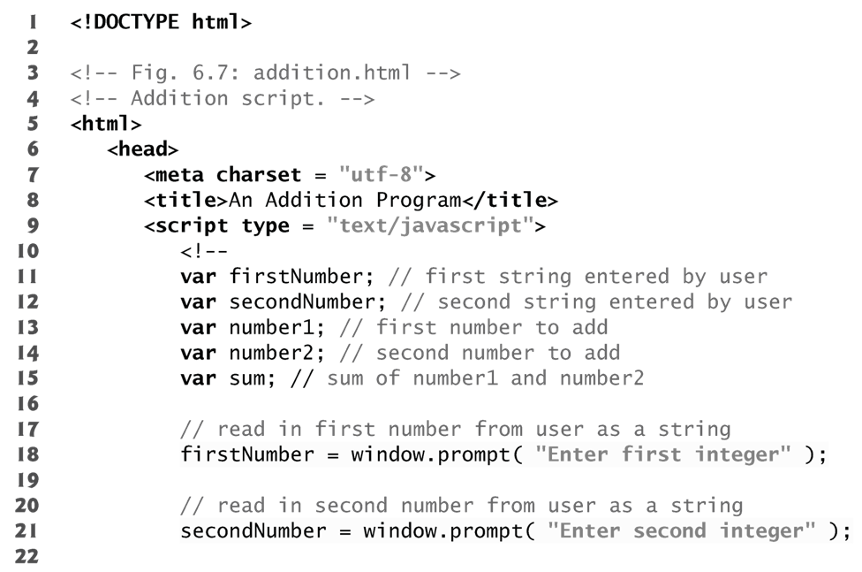
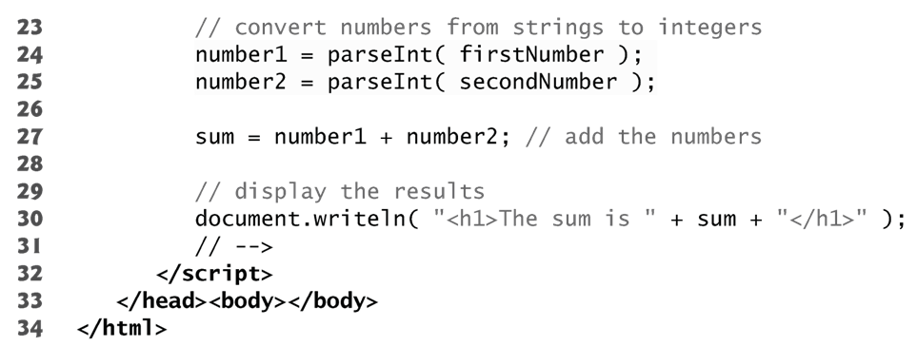

Slide 25
Dynamic Welcome Page
null keyword
Signifies that a variable has no value
null is not a string literal, but rather a predefined term indicating the absence of value
Writing a null value to the document, however, displays the word “null”
Function parseInt
converts its string argument to an integer
JavaScript has a version of the + operator for string concatenation that enables a string and a value of another data type (including another string) to be concatenated

Slide 26
Variable Types
JavaScript does NOT require variables to have a type before they can be used in a script
A variable in JavaScript can contain a value of any data type, and in many situations, JavaScript automatically converts between values of different types for you
JavaScript is referred to as a loosely typed language
When a variable is declared in JavaScript, but is not given a value, it has an undefined value.
Attempting to use the value of such a variable is normally a logic error.
When variables are declared, they are not assigned default values, unless specified otherwise by the programmer.
To indicate that a variable does not contain a value, you can assign the value null to it.

Slide 27
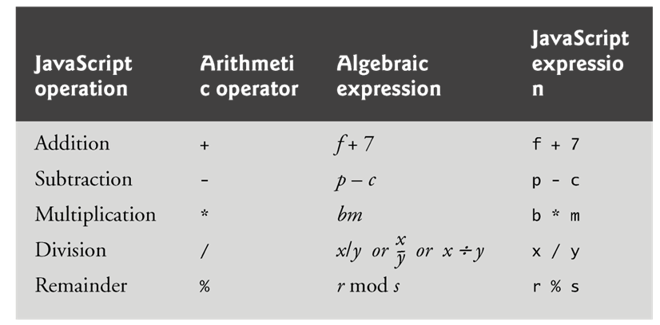
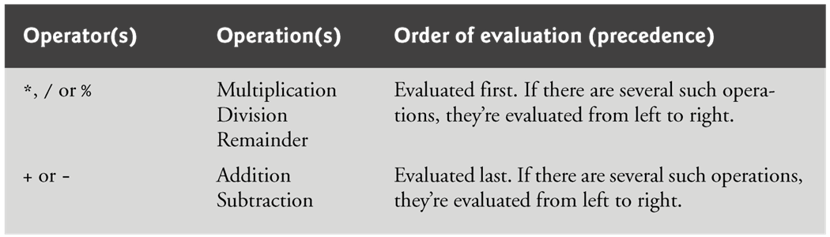
Arithmetic

Slide 28
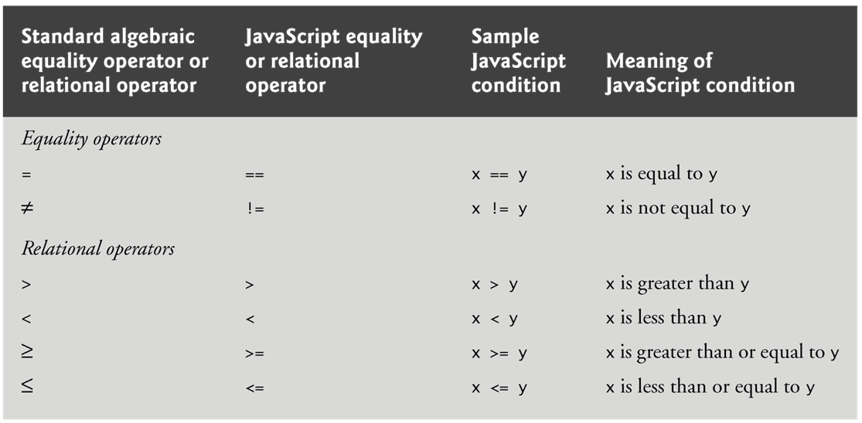
Decision Making: Equality and Relational Operators
if statement allows a script to make a decision based on the truth or falsity of a condition
Conditions in if statements can be formed by using the equality operators and relational operators

Slide 29
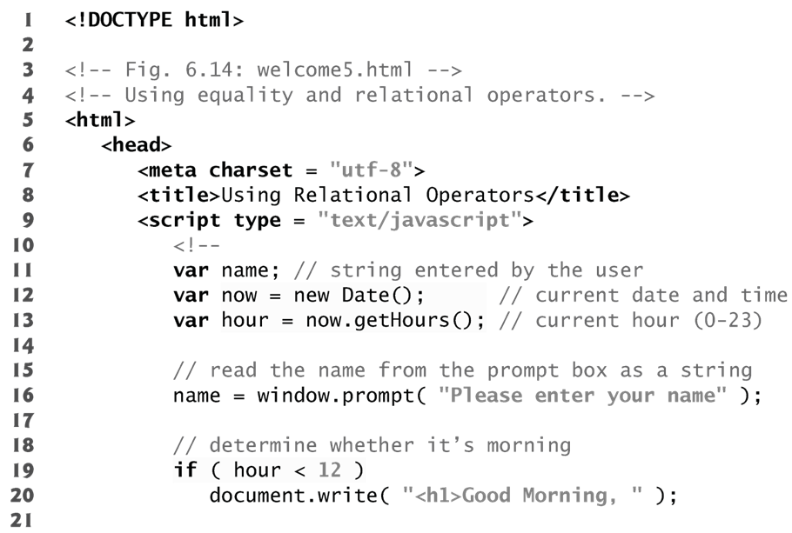
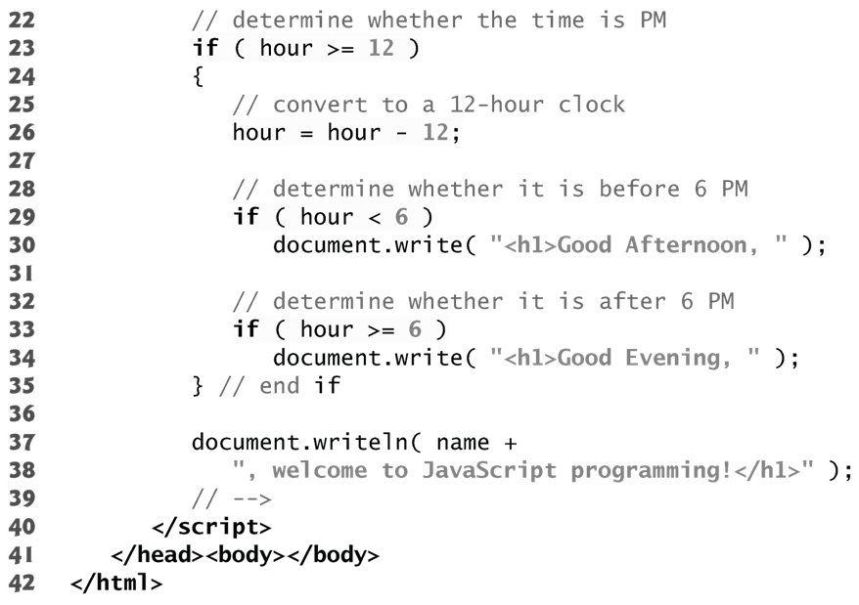
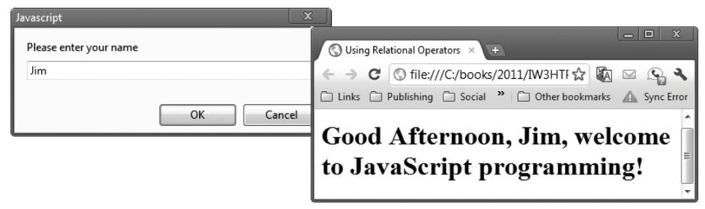

Slide 30
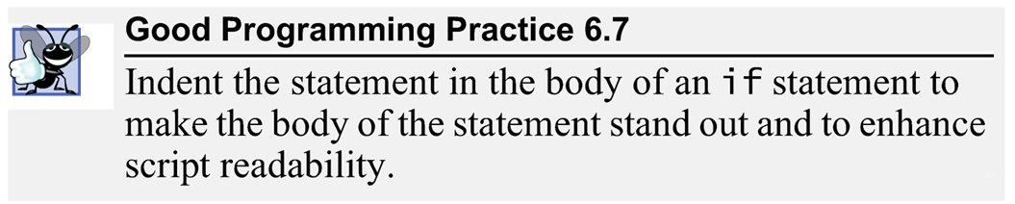
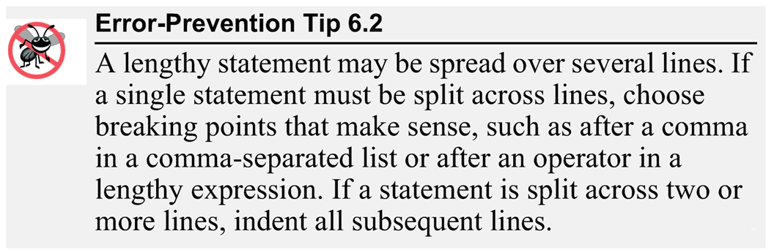
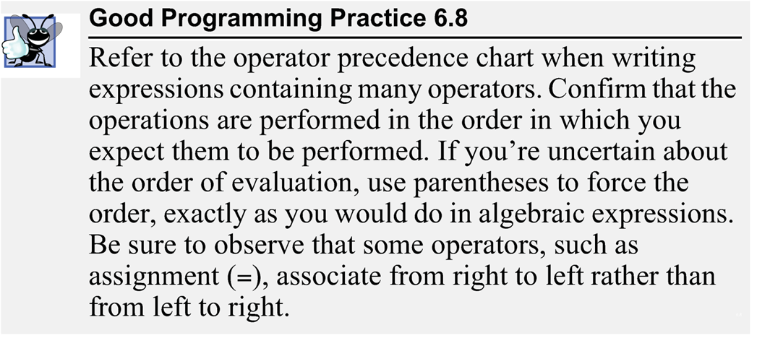

Slide 31
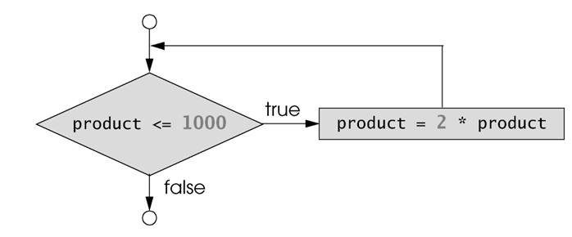
while Repetition Statement
Allows you to specify that an action is to be repeated while some condition remains true
The body of a loop may be a single statement or a block
Eventually, the condition becomes false and repetition terminates

Slide 32
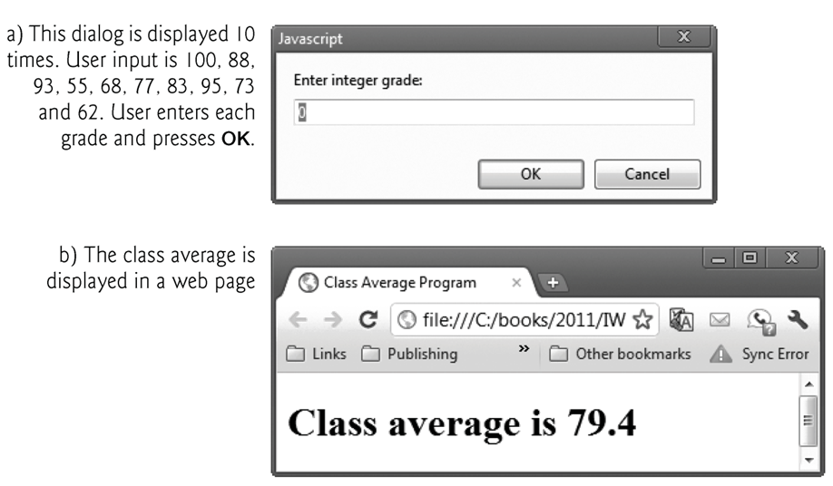
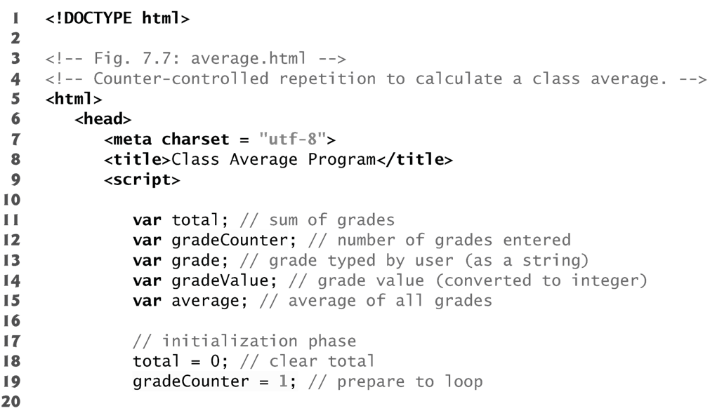
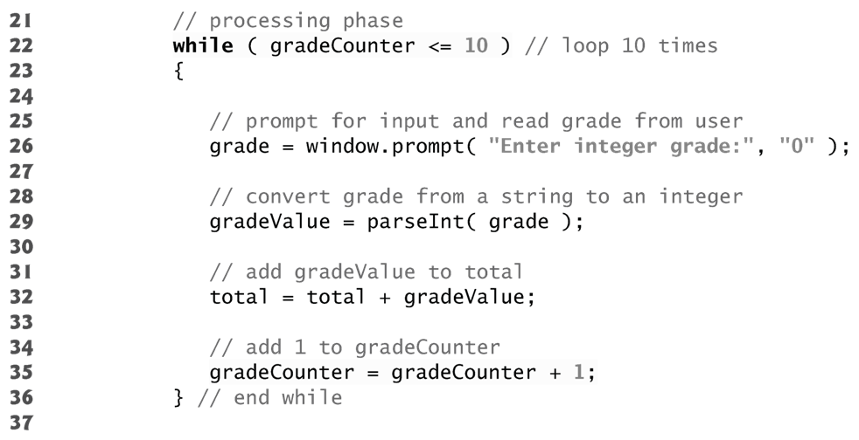

Slide 33
for Repetition Statement
for statement
Specifies each of the items needed for counter-controlled repetition with a control variable
Can use a block to put multiple statements into the body
If the loop’s condition uses a < or > instead of a <= or >=, or vice-versa, it can result in an off-by-one error
for statement header contains three expressions
Initialization
Condition
Increment Expression
The increment expression in the for statement acts like a stand-alone statement at the end of the body of the for statement

Slide 34
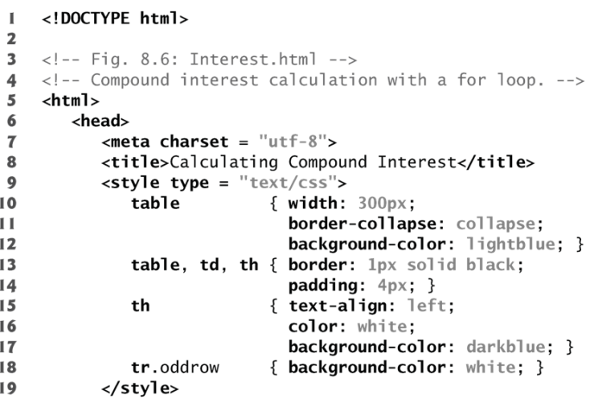
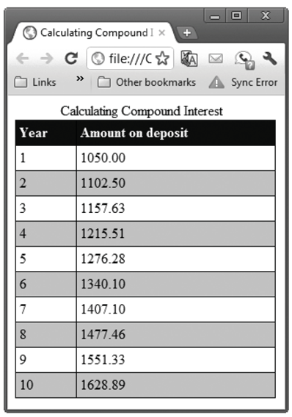
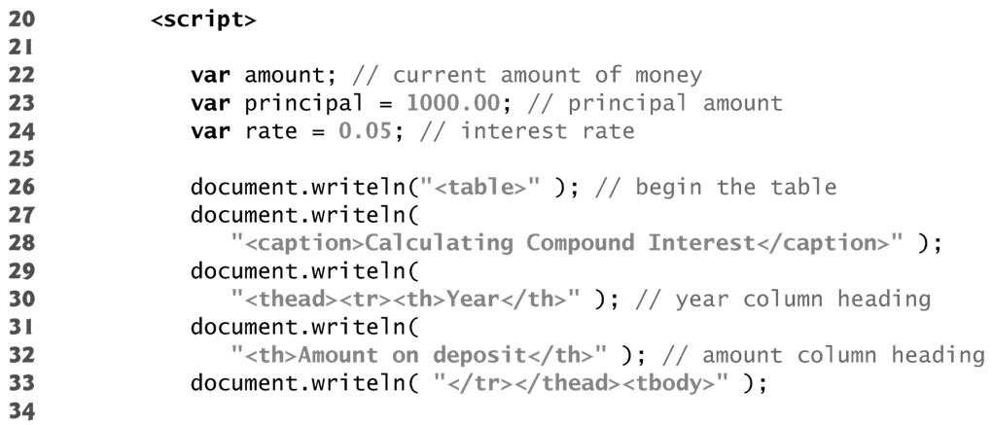
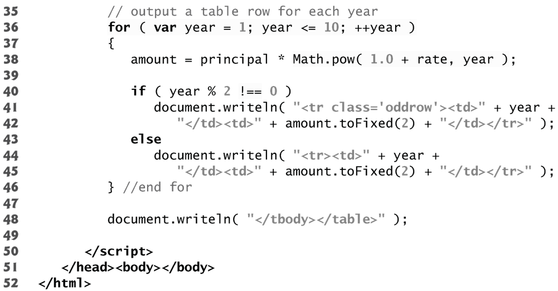

Slide 35
switch Multiple-Selection Statement
switch statement
Consists of a series of case labels and an optional default case
When control reaches a switch statement
The script evaluates the controlling expression in the parentheses
Compares this value with the value in each of the case labels
If the comparison evaluates to true, the statements after the case label are executed in order until a break statement is reached
The break statement is used as the last statement in each case to exit the switch statement immediately
The default case allows you to specify a set of statements to execute if no other case is satisfied
Usually the last case in the switch statement

Slide 36
switch Multiple-Selection Statement
Each case can have multiple actions (statements)
Braces are NOT required around multiple actions in a case of a switch
The break statement is not required for the last case because program control automatically continues with the next statement after the switch
Having several case labels listed together (e.g., case 1: case 2: with no statements between the cases) executes the same set of actions for each case

Slide 37
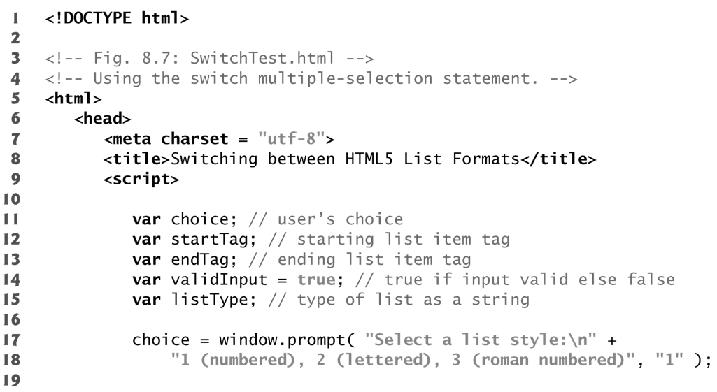
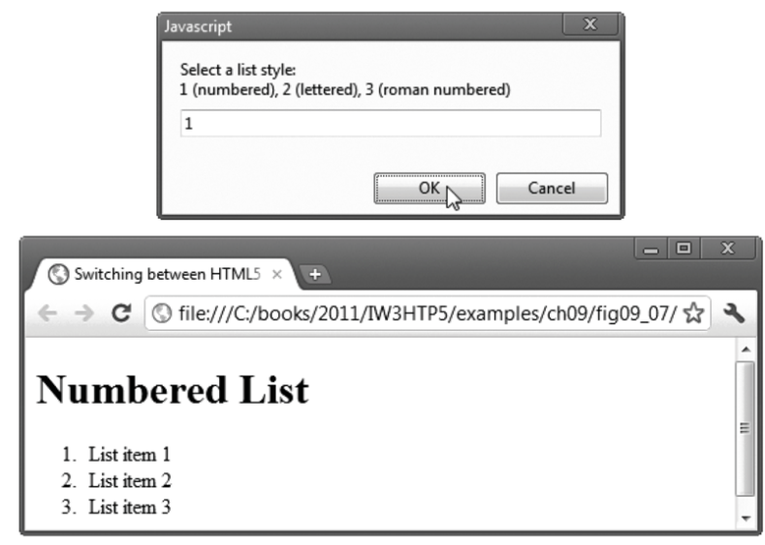
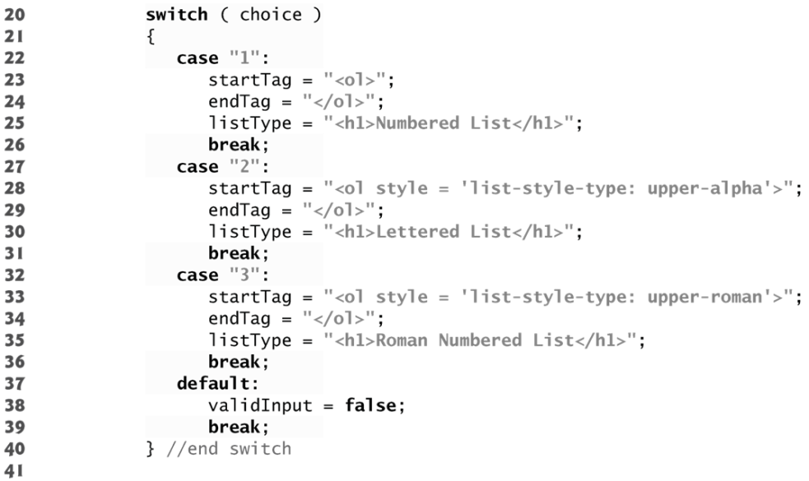
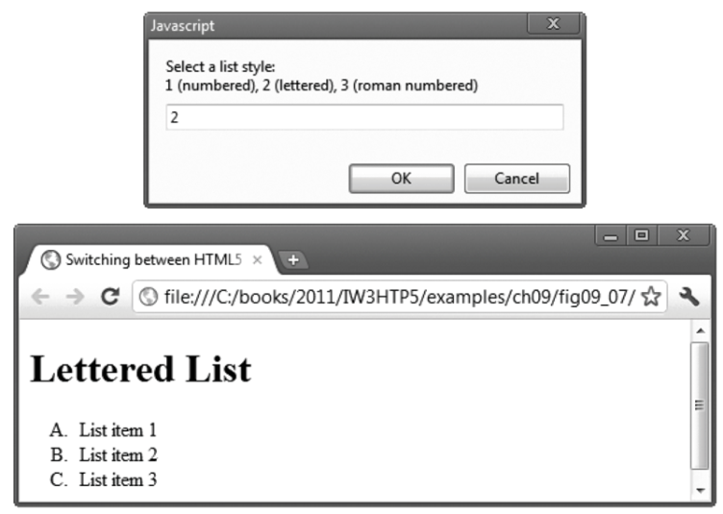
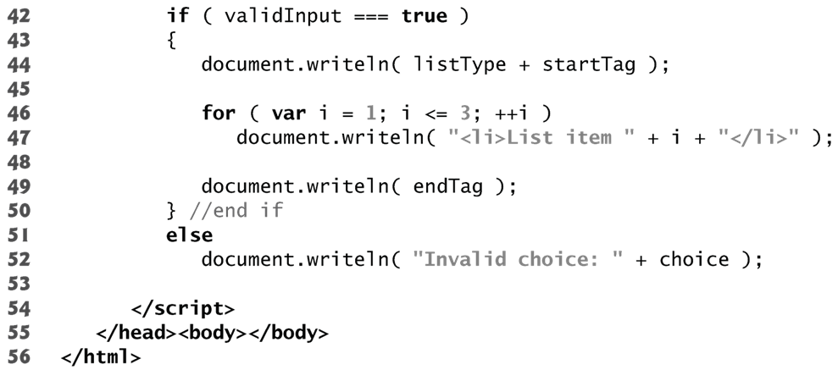
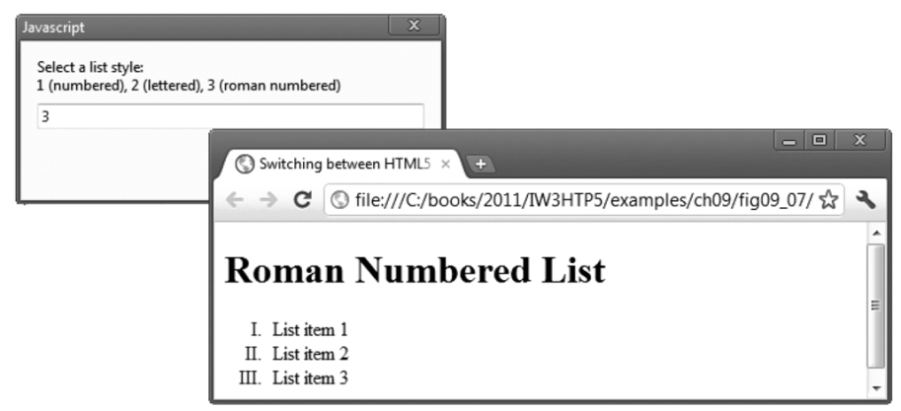

Slide 38
do…while Repetition Statement
do…while statement
tests the loop-continuation condition after the loop body executes
The loop body always executes at least once

Slide 39
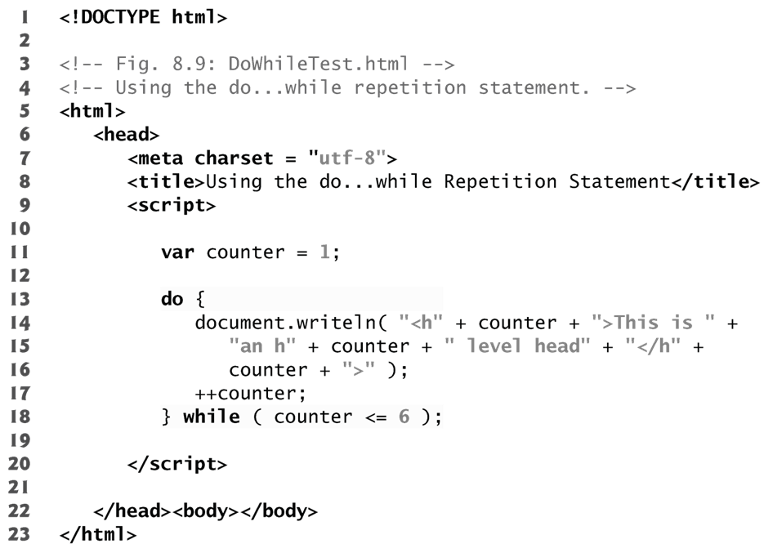
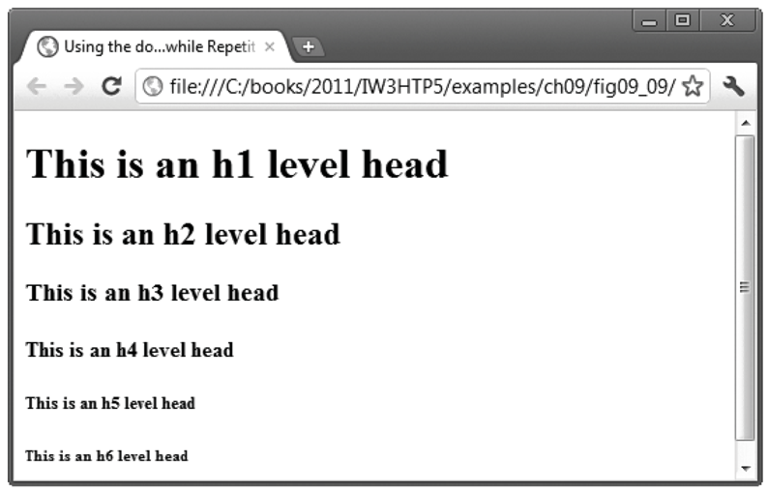

Slide 40
break and continue Statements
break statement in a while, for, do…while or switch statement
Causes immediate exit from the statement
Execution continues with the next statement in sequence
break statement common uses
Escape early from a loop
Skip the remainder of a switch statement

Slide 41
break and continue Statements
continue statement in a while, for or do…while
skips the remaining statements in the body of the statement and proceeds with the next iteration of the loop
In while and do…while statements, the loop-continuation test evaluates immediately after the continue statement executes
In for statements, the increment expression executes, then the loop-continuation test evaluates

Slide 42
Program Modules in JavaScript
You’ll combine new functions that you write with prepackaged functions and objects available in JavaScript
The prepackaged functions that belong to JavaScript objects (such as Math.pow, introduced previously) are called methods.
JavaScript provides several objects that have a rich collection of methods for performing common mathematical calculations, string manipulations, date and time manipulations, and manipulations of collections of data called arrays.

Slide 43
Program Modules in JavaScript
You can define programmer-defined functions that perform specific tasks and use them at many points in a script
The actual statements defining the function are written only once and are hidden from other functions
Functions are invoked by writing the name of the function, followed by a left parenthesis, followed by a comma-separated list of zero or more arguments, followed by a right parenthesis
Methods are called in the same way as functions, but require the name of the object to which the method belongs and a dot preceding the method name
Function (and method) arguments may be constants, variables or expressions

Slide 44
Programmer-Defined Function square
return statement
passes information from inside a function back to the point in the program where it was called
A function must be called explicitly for the code in its body to execute
The format of a function definition is
function function-name( parameter-list )
{
declarations and statements
}

Slide 45
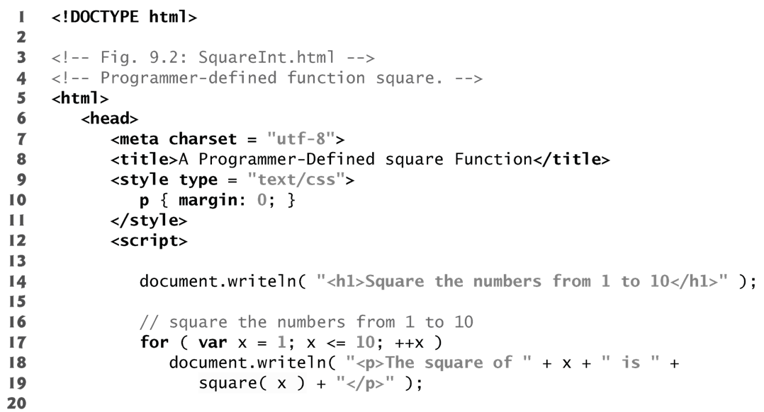
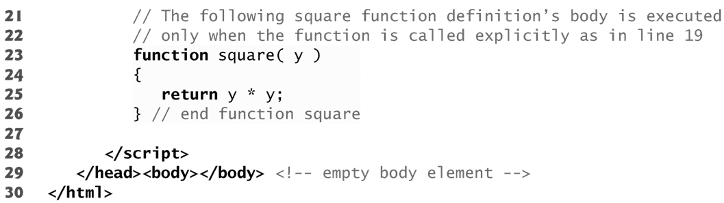
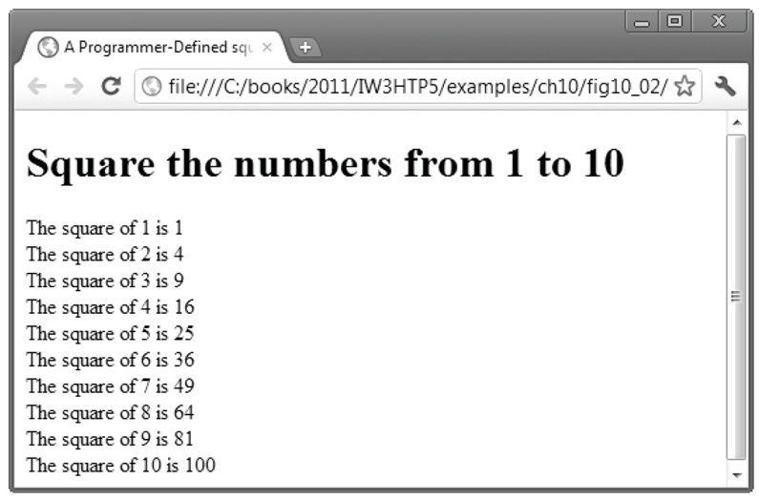

Slide 46
Notes on Programmer-Defined Functions
All variables declared with the keyword var in function definitions are local variables—this means that they can be accessed only in the function in which they’re defined.
A function’s parameters are also considered to be local variables.
There are several reasons for modularizing a program with functions.
Divide-and-conquer approach makes program development more manageable.
Software reusability.
Avoid repeating code in a program.

Slide 47
